Slide 1
Types of Databases system

Slide 2
There are various types of databases used for storing different varieties of data
Centralized Database system
Parallel Database System
Client/ Server Database System
Distributed Database System

Slide 3
Centralized database system
A centralized database is stored at a single location such as a mainframe computer.
It is maintained and modified from that location only and usually accessed using an internet connection such as a LAN or WAN.
The centralized database is used by organizations such as colleges, companies, banks etc.

Slide 4
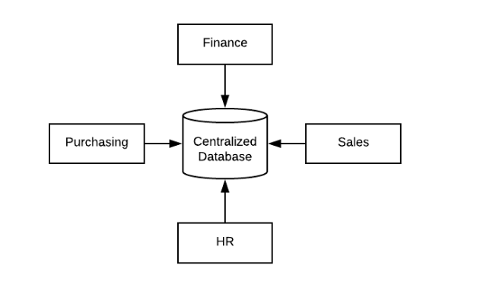

Slide 5
Parallel database system
A parallel database is one which involves multiple processors and working in parallel on the database used to provide the services.
A parallel database system seeks to improve performance through parallelization of various operations like loading data, building index and evaluating queries parallel systems improve processing and I/O speeds by using multiple CPU’s and disks in parallel.

Slide 6
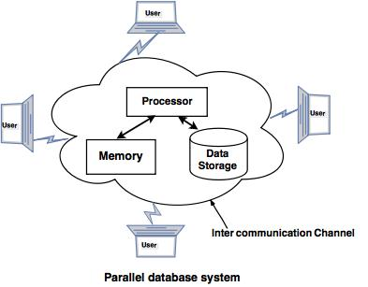

Slide 7
Client/Server database system:
Client/server is developed to deal with various computing environments that have a large number of computers and servers connected together via a network.
In this architecture, a Client is a user machine which provides the user interface and local processing capabilities.
When any client requires additional functionality like database access, it can connect to Server that is capable of providing the functionality needed by the client.
Basically Server is a machine that provides services to the Client i.e user machine.

Slide 8
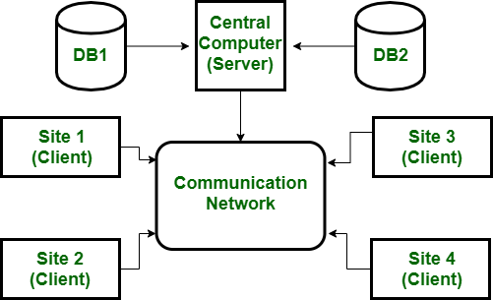

Slide 9
Distributed DBMS :
In Distributed DBMS, data is distributed over the geographical site.
Each site is a complete database system site on its end but the different sites have to work together because if any user wants to access the data it can easily access data anywhere in the network as the data is stored at the user’s own computer.

Slide 10
